Slide 1
Chromosomal Image Recognition A.I. (CIRA)
Alex Wurts, Daniel McDonough, Surya Vadivazhagu

Slide 2
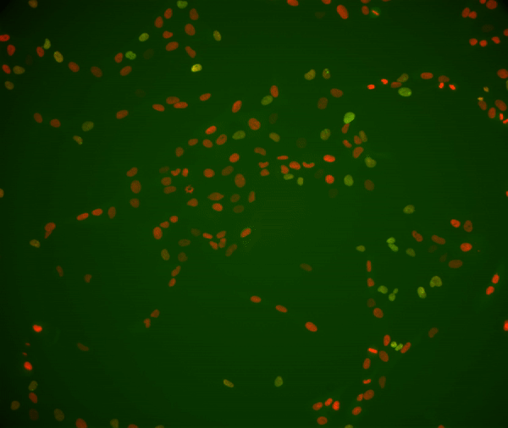
Currently in the world of cancer research...
Researchers at Manning Labs are testing different conditions and constraints of cell DNA replication to test their repercussions.
Researchers can label Non-damaged DNA as Red & Damaged DNA Foci as Green to determine if Cells with damaged DNA (via some induced condition) are more likely to become cancerous.
Problem: Analyzing this data has to be done by hand, or with limited help from proprietary software.
Video Courtesy of Manning Labs

Slide 3
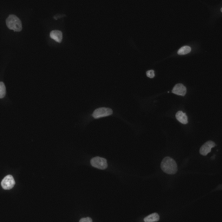
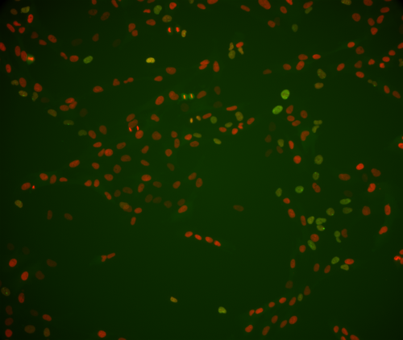
How does CIRA tackle this problem?
The CIRA Pipeline:
Preprocessing Phase 1
Cell Detection
Preprocessing Phase 2
Cell Classification
Evaluation
2 Datasets:
Testing Cell Detection: Kaggle 2018 Data Science Bowl (Left)
Testing Cell Classification: ManningLab Video Dataset (Right)

Slide 4


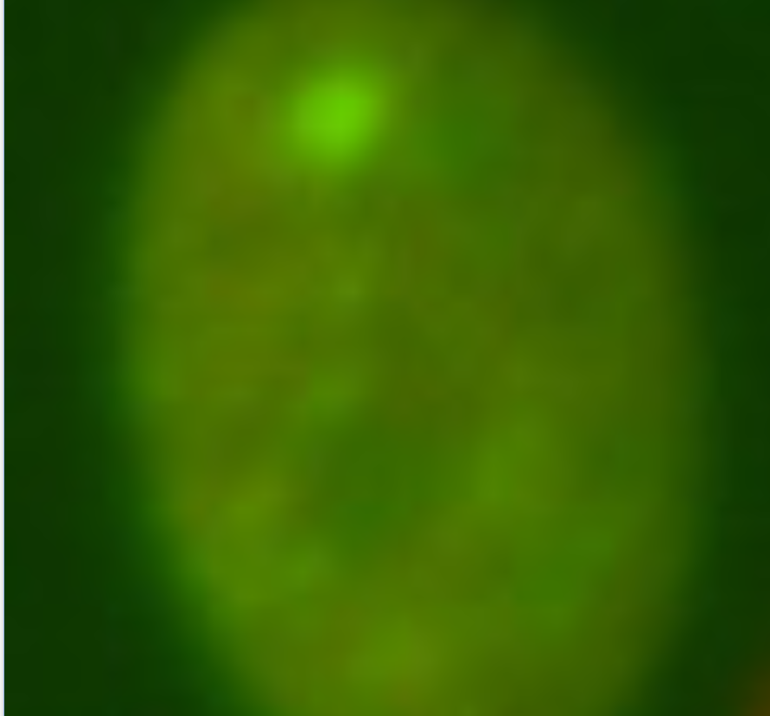
Preprocessing Phase 1:
R DNA
G Foci
Frame Data
(.TIF Images)
B Nothing
Given an “unreadable” binary .ND2 file
Remove all “Hazy” &
Missing Channel Frames

Slide 5
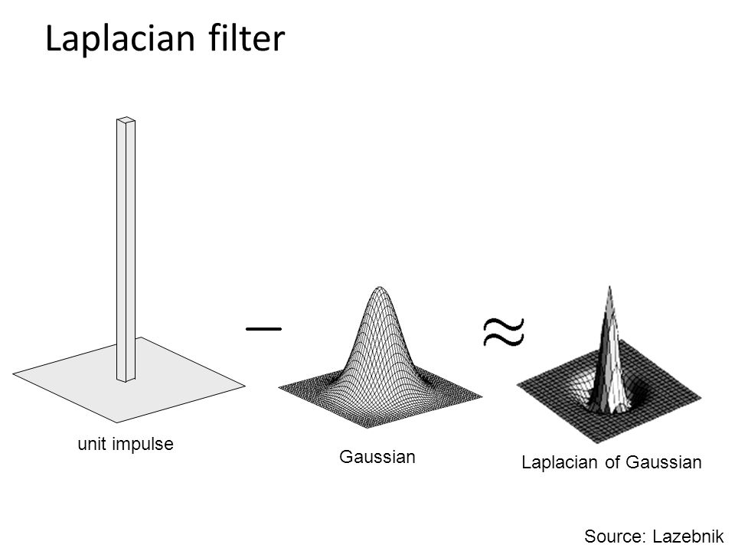
Cell Detection: Laplacian of Gaussian (LoG)
Using the SciPy implementation of LoG
Train over the Kaggle Dataset, to obtain best parameters:
Max-sigma
Min-sigma
N-iterations
Overlap
Threshold

Slide 6
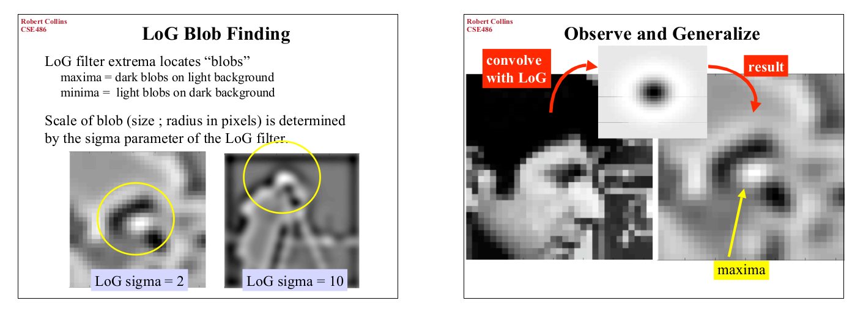
Cell Detection: Laplacian of Gaussian (LoG)
Slides from:www.cse.psu.edu/~rtc12/CSE486/lecture11_6pp.pdf

Slide 7
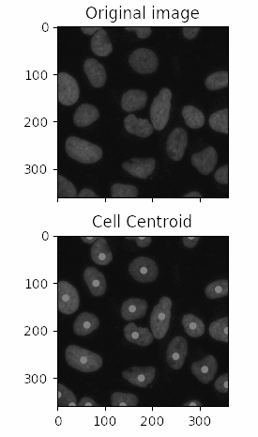


Cell Detection: Laplacian of Gaussian (LoG)
Using this method we are able to get:
Centroids and approximate Radii of each detected “Blob”
Which produces Fairly Clean Image cutouts of each “Blob”
~80% accuracy by Mean Accuracy Precision on Kaggle Set
Bright Cell Nucleus
Dark Cell Nucleus
2 Nuclei Together

Slide 8
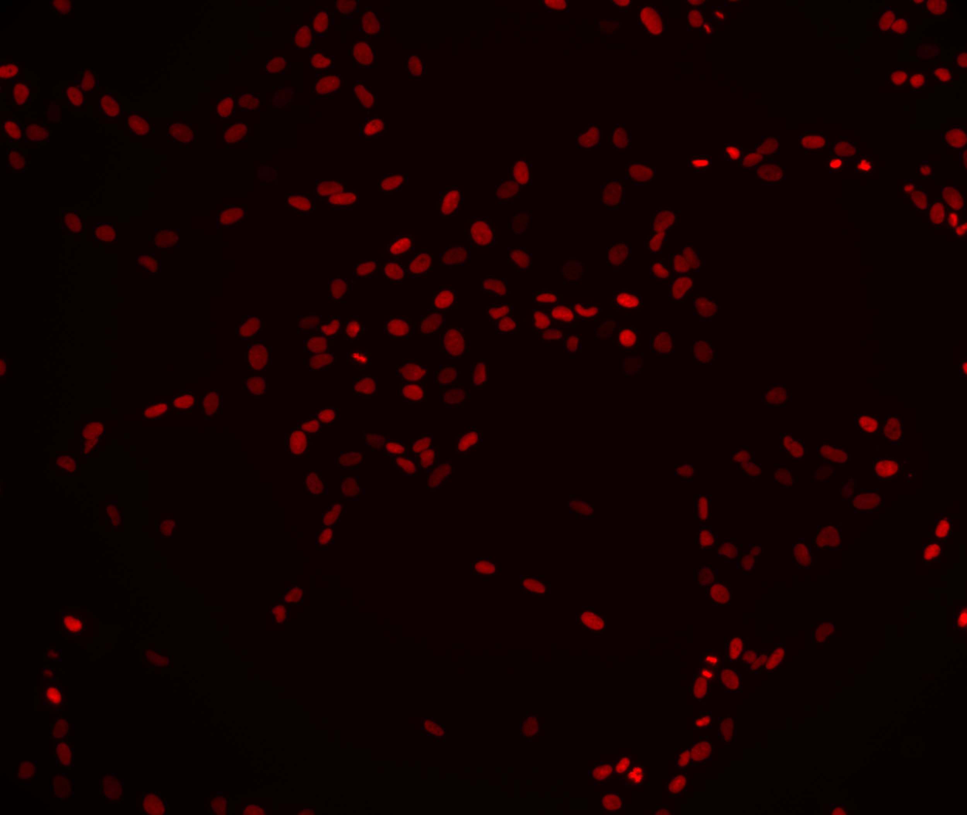
Preprocessing Phase 2
People can’t see foci in cells not in the frame
How can we expect a computer to do so?
We remove all cells that are partially out of frame first

Slide 9
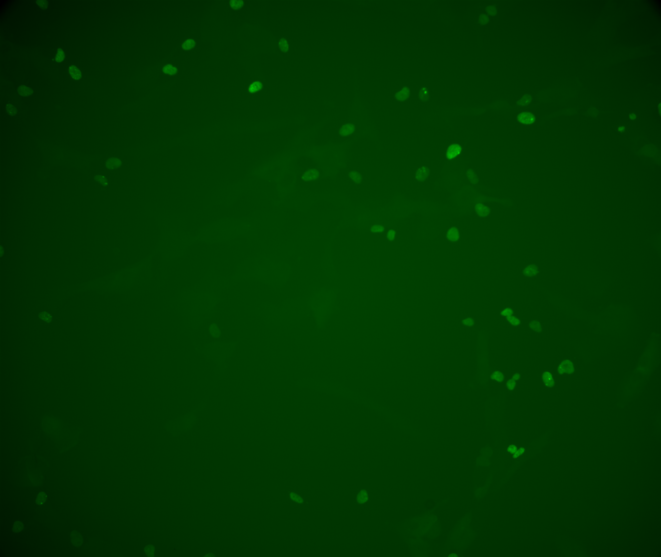
Preprocessing Phase 2
Determine cells as damaged based on the corresponding Green Channel

Slide 10
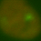
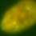

Preprocessing Phase 2
Perfect!
We can quickly determine a close approximation by checking if the max green brightness is present in over ¾ the average green in the image.
We then add the red channel back in, and use these as ground truths for Testing
This isn’t perfect...
Not so perfect...

Slide 11
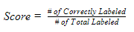
Cell Classification Methodology
Transform cell images into flattened input array of red values
For clustering:
Assessment: homogeneity_score and v_score
Agglomerative Complete Link, Agglomerative Ward, and K-Means
For classification:
Assessment:
Support Vector Machine (SVM), Logistic Regression, Multi-Layer Perceptron
Formula taken from CIRA paper
Notes:
We have individual images of cells. Unhealthy cells in one folder, healthy cells in another folder.
They are all varying sizes.
We are only focusing on the red values.
Our goal is to speed up the time for a biologist to classify cells by using clustering or classification.
They are all transformed into 20 by 20 images the flattened into a 400 value array.
The values are already standardized because image pixel values are from 0 to 255.
Run Algorithm through Clustering and Classification.
Both accomplish different objectives.
Clustering provides a better probability assessment of whether a cell is healthy or not.
Classification provides a better way of labeling cells for further experiments. Could potentially replace the green protein
Speed up experiment times.
We used homogeneity score and v score to assess clustering
And overall accuracy for assessing classification algorithms.
Sklearn was the source of the algorithm implementations.

Slide 12
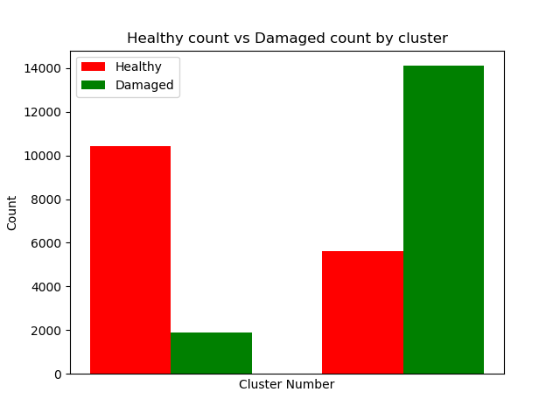
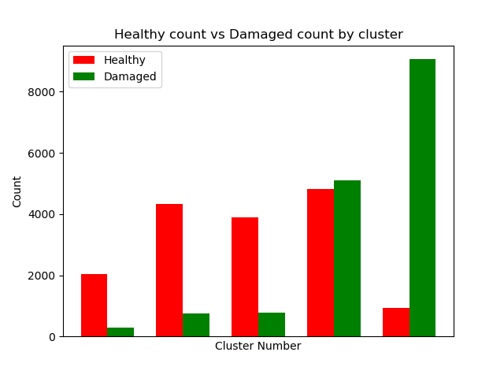
Cell Clustering Results
Two Clusters
Results for best clustering: K-Means
Two Cluster: Homogeneity Score: 0.2414 V Measure: 0.2466
Five Clusters
Five Cluster Homogeneity Score: 0.3237 V Measure: 0.2079
Notes:
Of the three clustering methods we used, Agglomerative with Ward, Agglomerative with Complete Link and K-means. Kmeans performed the best.
We tried it with both 5 and 2 clusters because we were working on providing a probability for a certain cell.
After clustering we can then see which group a new cell would be and provide a probability of healthy or unhealthy.
For example if a new cell was put into right-most category for five clusters we would have a high confidence it was unhealthy.
There would me more confidence of unhealthy than for the 2 cluster results.

Slide 13
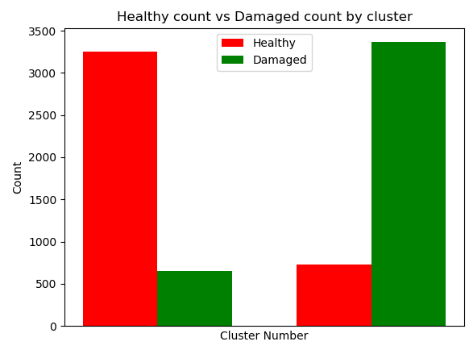
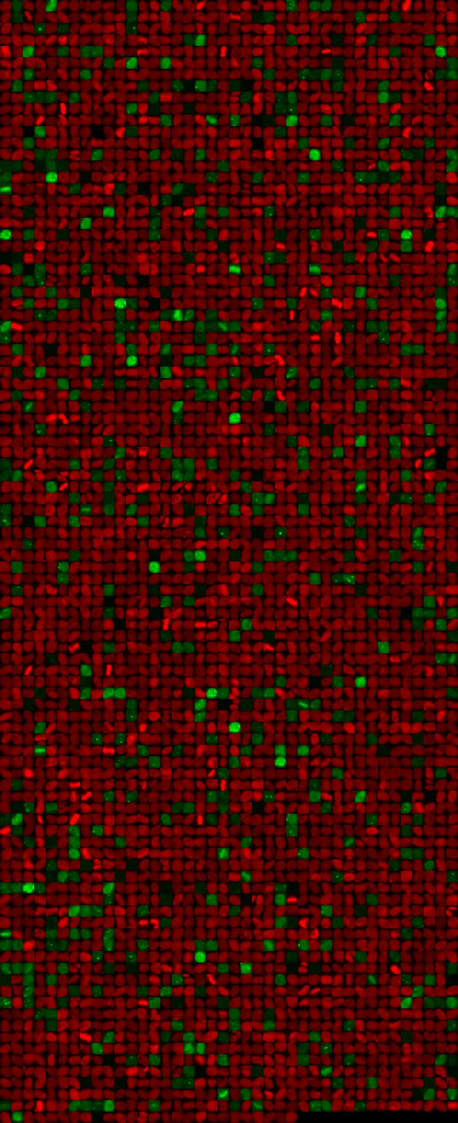
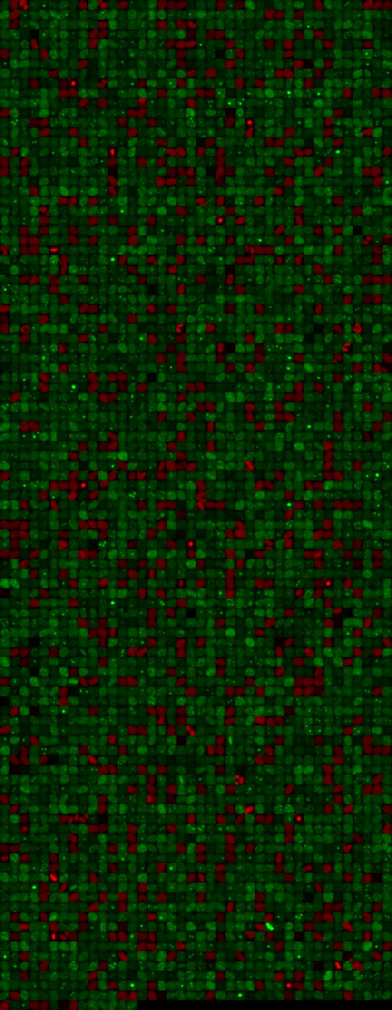
Cell Classification Results
Best Classification Results Logistic Regression Score: 0.827
Notes:
Red is healthy. Green is unhealthy. These are the actual pictures of cells classified using the logistic algorithm.
We produced red/green images for visualization to better understand the cells being classified.
Based on the score we have a 82.7% confidence with each classification
For example a new cell could be classified as healthy or unhealthy and we would have an 82.7% confidence it is correct.
The images help understand more visually how accurate the classification was. The graph can only show so much.

Slide 14
Conclusion
The C.I.R.A. Pipeline - Summarized
Cos-7 Labeled Video
Preprocessing
Detection using LoG over red channel.
Classification using Value threshold of green channel.
Breakdown into images
Overall average runtime speedup: ~45s → ~10s /image
82% confidence in classification..
Possibility of using GPU to speed up detection & classification.
Notes:
COS-7 is derived from monkey kidney tissue.

Slide 15
Thank You Questions?

Slide 16
References
[1]D. A. Manning, "Manning Lab," Worcester Polytechnic Institute, 2016. [Online]. Available: http://labs.wpi.edu/manninglab/. [Accessed November 2018].
[2]Booz Allen Hamilton and Kaggle, "2018 Data Science Bowl," Kaggle, April 2018. [Online]. Available: https://www.kaggle.com/c/data-science-bowl-2018. [Accessed November 2018].
[3]S. Kiriyama, "Nikon ND2 Reader," Nikon Instruments Inc., 4 May 2014. [Online]. Available: https://imagej.nih.gov/ij/plugins/nd2-reader.html. [Accessed November 2018].
[4]T. P. Ledesma-Fernández E, "Fluorescent foci quantitation for high-throughput analysis," Journal of Biological Methods, 19 July 2015. [Online]. Available: http://www.jbmethods.org/jbm/article/view/62/54. [Accessed November 2017].
[5]A. Rosenberg and J. Hirschberg, "V-Measure: A conditional entropy-based external cluster evaluation measure," Association for Computational Linguistics, pp. 410-420, 2007.
[6]E. Yilmaz and J. A. Aslam, "Estimating average precision with incomplete and imperfect judgements," CIKM '06 Proceedings of the 15th ACM international conference on Information and knowledge management, pp. 102-111, 2006.
[7]A. Patil and M. Dhanvijay, "Blob detection technique using image processing for identification of machine printed characters," INTERNATIONAL JOURNAL OF INNOVATIONS IN ENGINEERING RESEARCH AND TECHNOLOGY, vol. 2, no. 10, pp. 1-8, 2015.
8]E. Meijering, "Cell Segmentation: 50 Years Down the Road [Life Science]," IEEE Signal Processing Magazine, vol. 29, no. 5, pp. 140-145, 2012.
[9]M. Everingham, L. V. Gool, C. K. I. Williams, J. Winn and A. Zisserman, "The PASCAL Visual Object Classes (VOC) Challenge," International Journal of Computer Vision.
[10]B. E. Boser, I. M. Guyon and V. N. Vapnik, "A training algorithm for optimal margin classifiers," COLT '92 Proceedings of the fifth annual workshop on Computational learning theory, pp. 144-152, 1992.
[[11]P. K. Agarwal and N. H. Mustafa, "k-means projective clustering," PODS '04 Proceedings of the twenty-third ACM SIGMOD-SIGACT-SIGART symposium on Principles of database systems, pp. 155-165, 2004.
[12]Pedregosa et al., "Scikit-learn: Machine Learning in Python," JLMR 12, pp. 2825-2830, 2011.
[13]E. Ledesma-Fernández and P. Thorpe, "Fluorescent foci quantitation for high-throughput analysis", Jbmethods.org, 2018. [Online]. Available: http://www.jbmethods.org/jbm/article/view/62/54. [Accessed: 04- Dec- 2018].
[14] R. Crane, “Automatic Cell Detection and Tracking,” IEEE Transactions on Geoscience Electronics, vol. 17, no. 4, pp. 250–262, Oct. 1979.
[15]A. Ming and H. Ma, “A blob detector in color images,” in Proceedings of the 6th ACM international conference on Image and video retrieval - CIVR ’07, 2007.
[16]C. Zhang et al., “White Blood Cell Segmentation by Color-Space-Based K-Means Clustering,” Sensors, vol. 14, no. 9, pp. 16128–16147, Sep. 2014.
[17]"CS7960 - Project 1 | James Fishbaugh", Cs.utah.edu, 2018. [Online]. Available: http://www.cs.utah.edu/~jfishbau/advimproc/project1/. [Accessed: 04- Dec- 2018]
[18]R. L. Joshi and T. R. Fischer, “Comparison of generalized Gaussian and Laplacian modeling in DCT image coding,” IEEE Signal Processing Letters, vol. 2, no. 5, pp. 81–82, May 1995.
[19]"scikit-image/scikit-image", GitHub, 2018. [Online]. Available: https://github.com/scikit-image/scikit-image/blob/master/skimage/feature/blob.py#L278. [Accessed: 04- Dec- 2018]
[20]Everingham, M., Eslami, S.M.A., Van Gool, L. et al. Int J Comput Vis (2015) 111: 98. https://doi.org/10.1007/s11263-014-0733-5
[21]Y. Yue, T. Finley, F. Radlinski, and T. Joachims, “A support vector method for optimizing average precision,” in Proceedings of the 30th annual international ACM SIGIR conference on Research and development in information retrieval - SIGIR ’07, 2007.

Slide 17

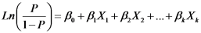
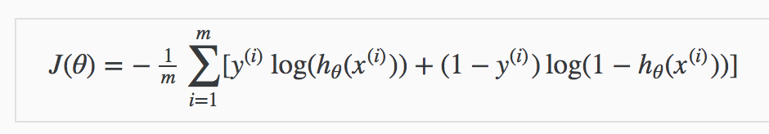
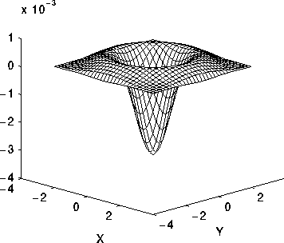
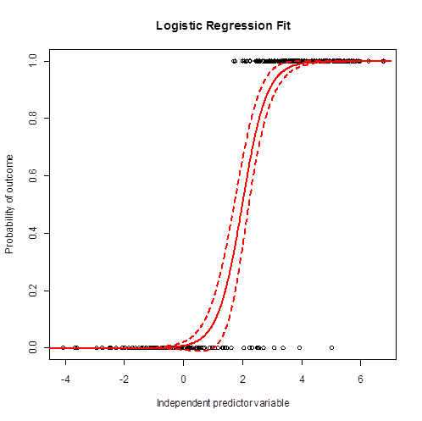
A Summary
C I R A
Weights

